Slide 1
Line Tracking
Simulation
By Ali Abdel Ghaffar

Slide 2
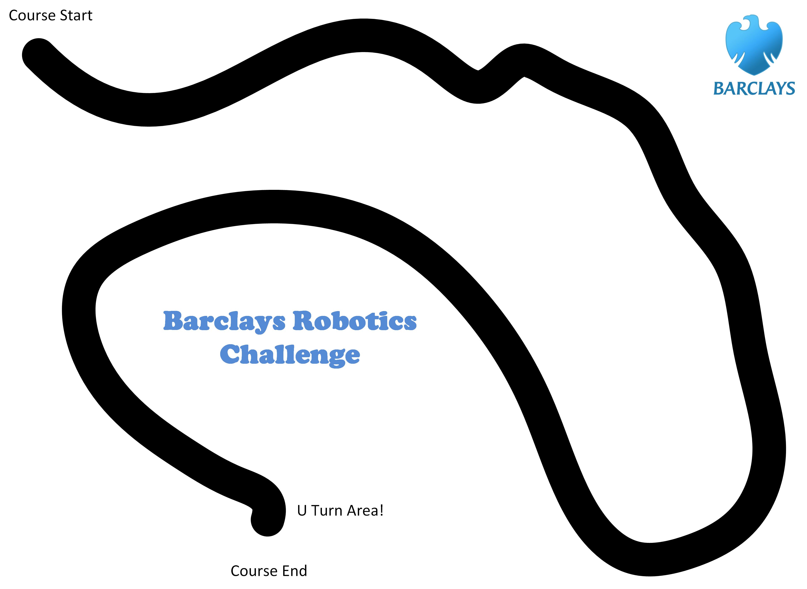
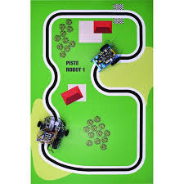
Line tracking

Slide 3
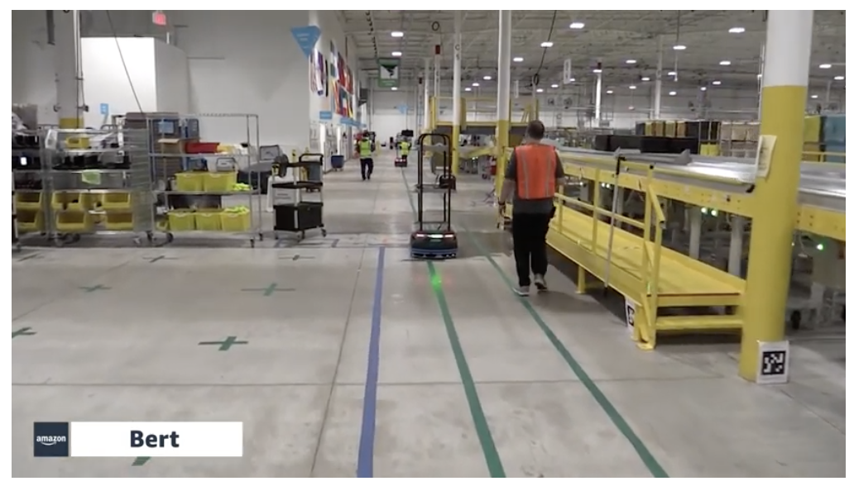
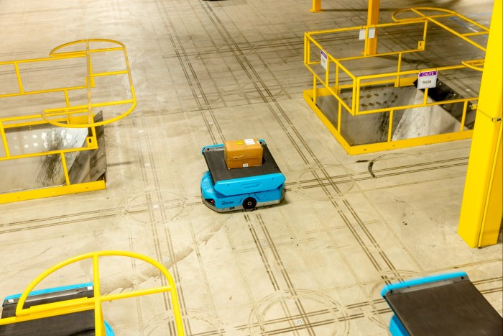
I
Line tracking IN action

Slide 4
VariableS
Essential Variables: the readings of the sensors
Noise: The line is random ( I implemented it as sinusoidal movement)
Controller: PID
Actuator: the motors but they it has some delay, because when the motors act, the line position would be already changed with respect to the robot.

Slide 5
How far are the sensors might be from the line
Comparator
(compare the light values with the supposed values)
Controller
(PID)
Actuator
(Move the robot, in this case the sensors)
Sensor
(get values from the sensors)
Environment
Feedback
(Where is the line now)

Slide 6
PID Controller
P: Proportional
I: Integral
D: Derivative

Slide 7
Event ide

Slide 8
Limitations
What if the line disappeared for any reason?
What if there are U turns in the line?
What if the line is dashed not a solid line?

Slide 9
THANK YOU for listening
Ali Abdel Ghaffar
Dr. Samy Rima

